Slide 1

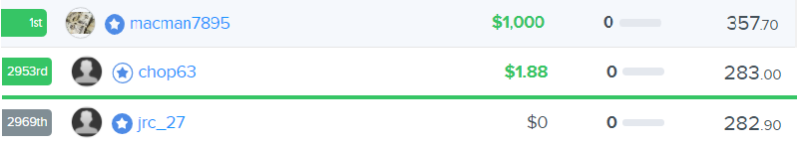
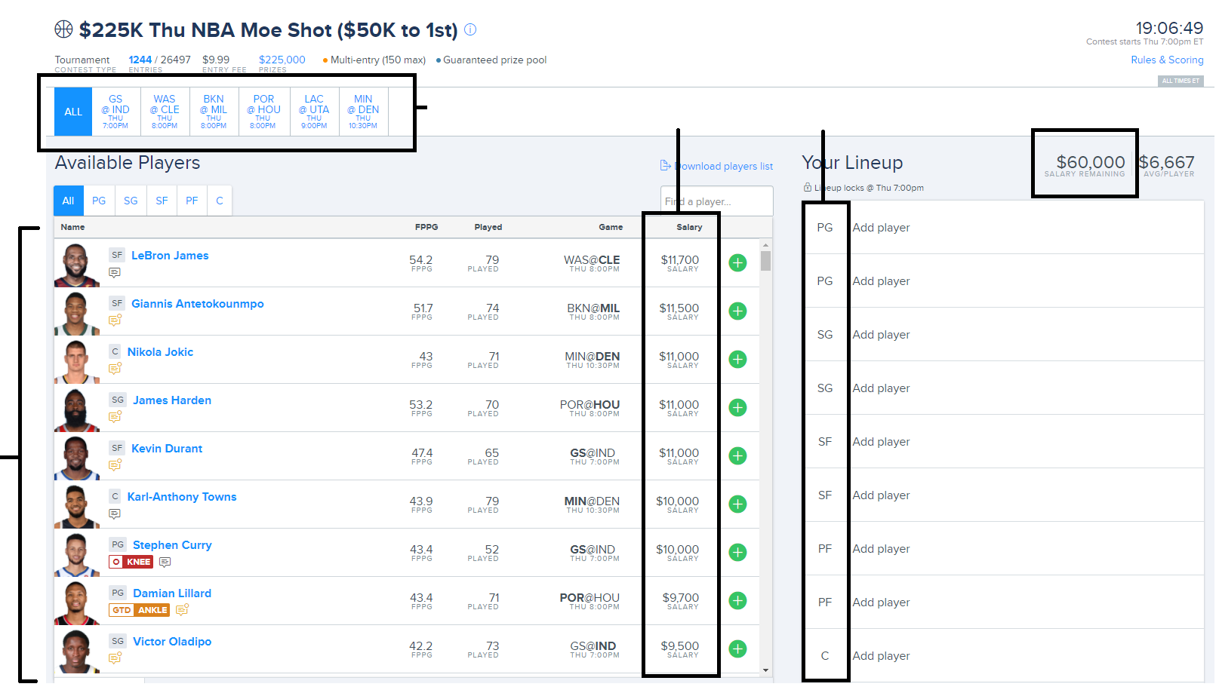

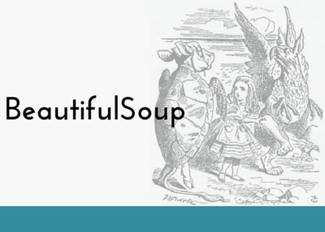
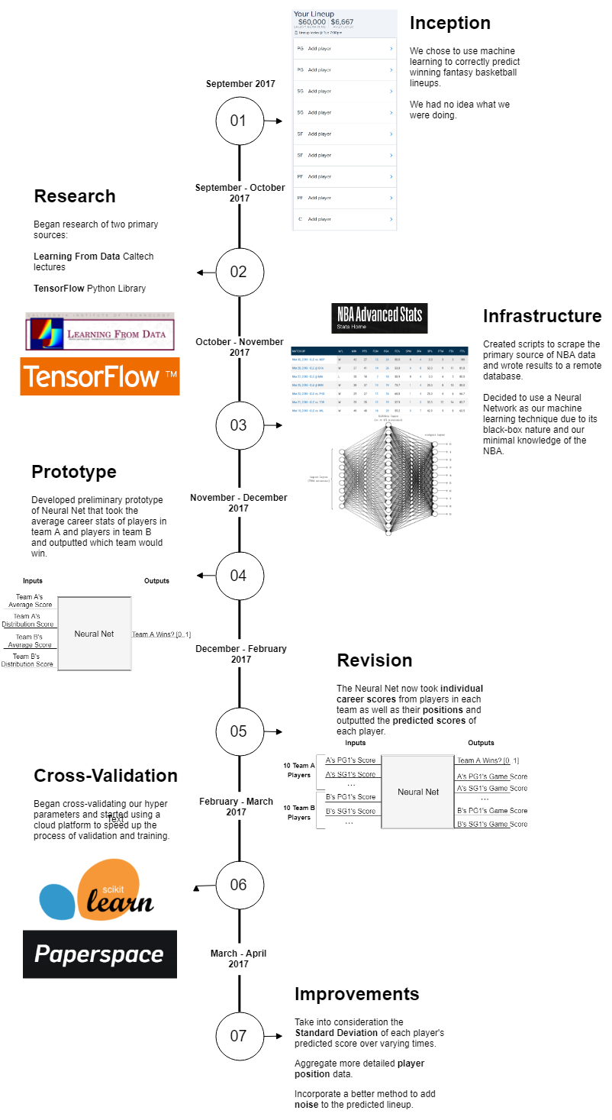

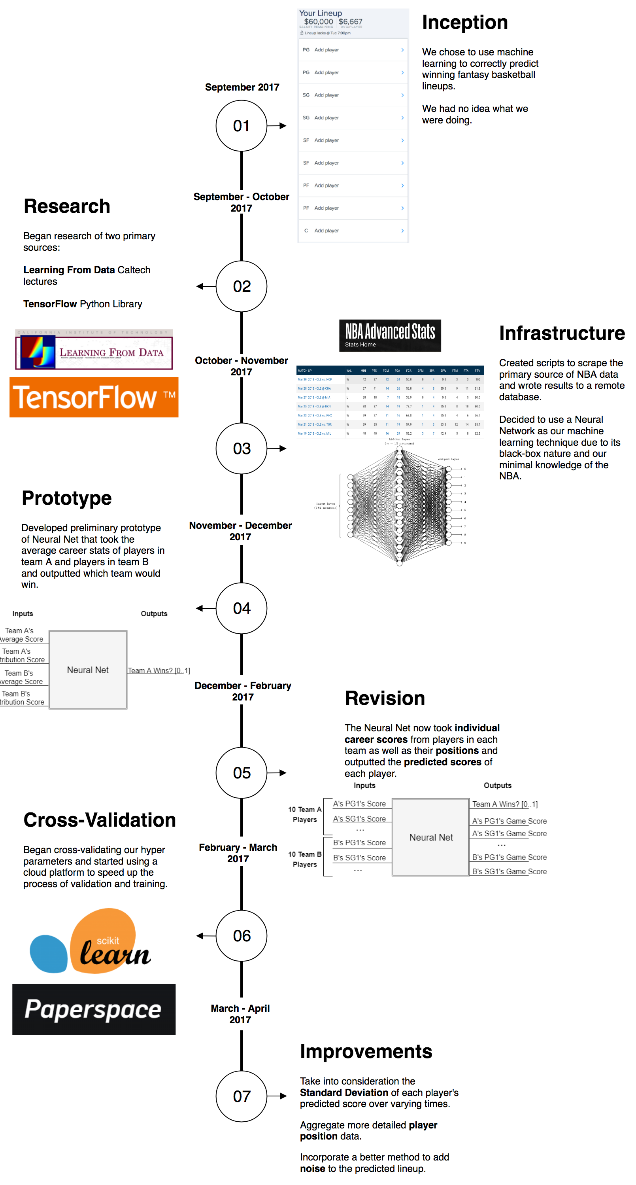
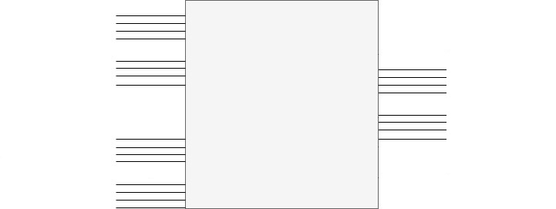
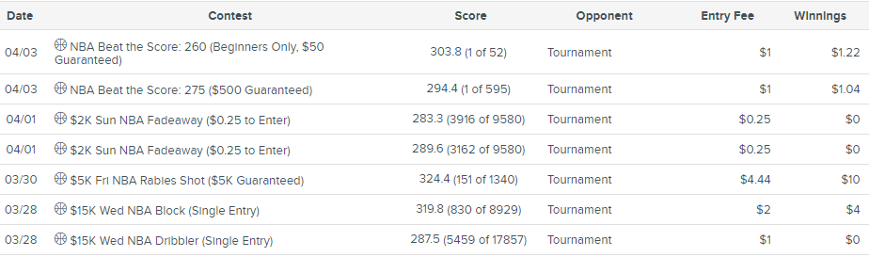
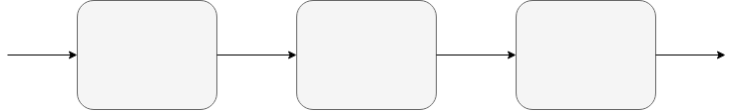
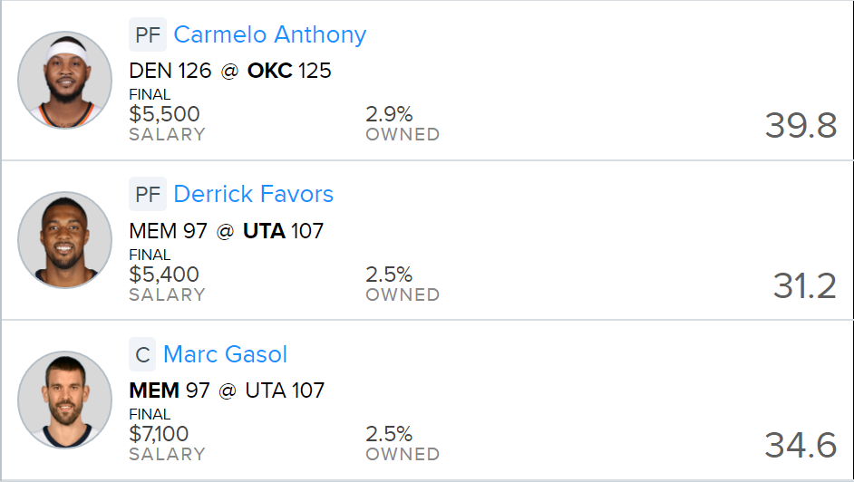
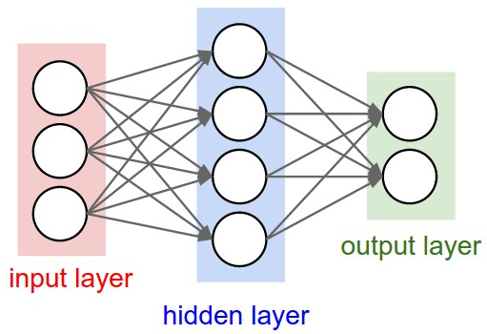
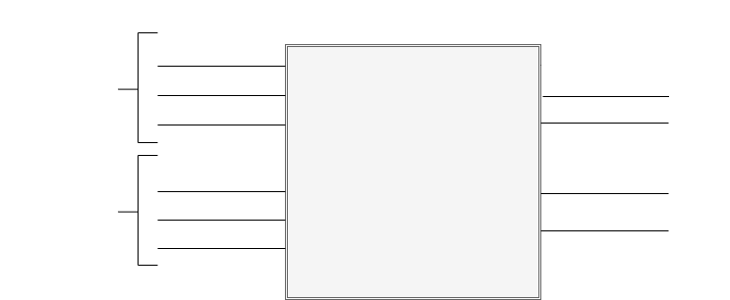
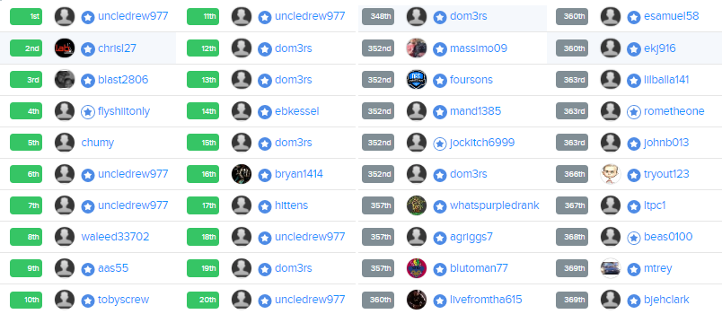


Picking Winners for Fantasy Basketball with Machine Learning
April 5th 2018
ECSE 457
Group 23
Authors: Ege Aydede, Stephen Poole, Florence Regol, Asher Wright
Supervisor: Dr. Psaromiligkos
1
3
5
6
Objective & Background
Data Collection
Results
Future Plans
The goal of this project was to make a machine learning system that could compete profitably in daily fantasy NBA competitions.
Daily means the competitions happen every day that there are matches (not fantasy leagues)
Fantasy means that they use a contrived points system
NBA means that they are based on actual NBA games
Competition means we are competing against real people
In these competitions, you have to select 9 basketball players of specific positions (e.g. center) who are playing tonight in real games, across any teams. Each player has a salary, and you have a budget. The goal of the competition is to maximize the amount of fantasy points your lineup gets.^{[1]}
With the model for our system chosen, we could begin collecting our data. The inputs to our system are NBA statistics. We built a scraper to obtain data from the NBA website (chosen for reliability). We scraped partial data from games back to 1970, and complete back to 2004:
Defining a success metric for our lineups was nontrivial. The ideal metric is the profitability of the system, but this is incomputable without competition history. Thus, we selected a heuristic metric: the lineup’s score relative to that of the best possible lineup that day.
$$Sucess\left(lineup\right)= \frac{lineup^{′}s fantasy score}{best lineup^{′}s score}$$
By looking at competitions, we determined that this heuristic implies profitability at around 80% and greater. In other words, if we can score 80% of the maximum possible score, we can win. The figure below shows this relationship, where the last winning score is roughly 79% of the maximum.
We did not think our network was going to be nearly as successful as it was, but it is still far from perfect, and not reliably profitable. We plan to continue to pursue and improve this project. Some ways to improve include:
Add additional valuable features
Define a better score function
Perform more cross-validation (e.g. on data amount used)
Performing Boosting and/or Bagging
Factor standard deviation into LP
Find more precise player positions
7
Today’s
Games
Player
Salaries
Required
Positions
Budget
We used Python to power our scraper
We used BeautifulSoup^{[4]} to retrieve the NBA website
We used Selenium^{[5]} to control the NBA website
In order to improve this metric (started at ~60%), we performed cross-validation – a method of selecting the best hyperparameters of our NN. These hyperparameters include the number of hidden nodes, hidden layers, and the learning rate. This is a computationally heavy process, and so we rented a GPU from Paperspace.^{[6]}
With cross-validation, we were able to hit a success metric of 82% - just above the minimum profitability line. Thus, we started joining competitions, and immediately ran into some initial issues:
Non-updated database
Players who didn’t end up playing that night
Accidentally ignoring players in some games
Using the wrong data for a player
We solved these issues and continued testing. To our surprise, the system was somewhat successful. Below are screenshots of the competition summaries for all of the competitions we played in where all of our players played.
Timeline
4
Today’s
Players
System Architecture
Our first architecture was a NN with multiple inputs for all active NBA players: their stats, and an “are they playing tonight” indicator. The NN had one output per player: a value indicating if the player should be in the lineup.
Our goal was to build a machine learning system to predict these lineups and maybe even win some money (unlikely!)
All currently active players’ stats
…
Lineup
indicators
Neural
Network
“Who’s Playing” indicators
…
…
2
This preliminary model had limitations:
It would be tough for the network learn what the inputs mean
Active players by nature mean we can’t use data from old games
The network will find correlations between unrelated players
The salary constraint is not handled
Instead, we spent time on architecture, and came up with a much better second solution, composed of 3 Systems:
Neural Network
We decided to use a neural network (NN) to solve our design problem. A NN is useful under the following criteria, which our design problem met:
There has to be a distinguishable pattern between the inputs (player stats, games) and the outputs (lineups) of the system
The relationship cannot be trivially represented mathematically, otherwise no reason to use machine learning
There must be enough data to properly "train" the network
But what is a neural network?
Below is a graphic of a simple NN, with one hidden layer, two outputs, and three inputs.^{[2]} This network, for example, could be attempting to find the relationship between the age, weight, and height of a person and their country of birth and gender.
Sometimes our predictions are neat: We make good picks that others miss! In our best lineup, our players were picked on average 7.5% by others. The nearest competitor in score averaged 27%. Three of these neat picks:
Data
System 1
Player Scores
System 2
Matches NN
System 3
Lineup ILP
Lineups
System 1 is unrelated to the neural network and computes the players' "scores" with a simple function. The scores roughly represent how good the players are at scoring fantasy points.
System 2, the neural network, now computes the “game scores” of players: a prediction of how many fantasy points they will get in a specific game. The NN is trained and tested on single matches, with far fewer inputs (42). The inputs are the players’ season scores and their recent scores, both computed by System 1. These inputs are sorted by position, as can be seen below:
As well, one can see that, even in the competitions we lose, we do not perform that poorly (always top 50%). But who are we up against? Pros!
A
C
System 1 Scores
Game Scores
W
G
Inputs for 7 Team A Players
PG Season
A’s PG game score
PG Recent
A’s SF game score
H
SF Season
Inputs for 7 Team B Players
…
System 2 Matches NN
…
PG Season
B’s SF game score
PG Recent
B’s SF game score
SF Season
…
There are two main "stages" of a Neural network.
1. Feed forward, or how outputs are computed from inputs
When feeding an input through the network, every edge (line) is a weight to multiply the value by, and every node (circle) is an "activation function" on the incoming value.
2. Back propagation, or how the system learns
Once an input is fed through the network, the error can be calculated.^{[3]}
$$E=\frac{1}{2}\left\|y−y^{′}\right\|$$
Where y is the actual output and y’ is our feed-forward prediction. The goal is to adjust the weights of the edges to reduce this error. This is done by "backpropagating" the error through the network. Then, the weights are adjusted, and the network’s performance will increase.
…
This network is not tied to specific players. We lose this information, but in turn we get to train this on all NBA matches, not just the ones with active players. As well, now that we test matches individually, they are independent, and there is no correlation. We have solved the first three limitations!
System 3 solves the fourth limitation: the salary constraint problem.
Given a bunch of players with scores, positions, and salaries, under positional constraints and a salary budget, pick a lineup to maximize the total score.
We solved this problem using a Python library called PuLP – a linear programming optimization solver.
We were then able to get multiple lineups by adding random Gaussian noise to the outputs of the NN before feeding them to the LP problem.
A white star in blue means they have been in over 1000 competitions and have won at least $1000 across four contests.
A blue star in white means they have been in at least 500 competitions or have won at least $1000 across four contests.
Looking through by hand, we found that ~85% of people have one type of these star in these competitions! This is true of the winners and the losers.
Our neural network was able to perform quite well against these experienced players, turning a profit in lineups that had all players active.
However, the system is still far from being reliably profitable, as its outputs are high in variance. There are still improvements to be made!
Referenced within:
[1] https://www.fanduel.com/contests
[2] Karpathy, "Convolutional Neural Networks for Visual Recognition", Stanford. [Online]. Available: http://cs231n.github.io/neural-networks-1/
[3] Abu-Mostafa, Yaser. "Learning From Data", Caltech, 2012. [Online]. Available: https://work.caltech.edu/telecourse.
[4] https://www.crummy.com/software/BeautifulSoup/
[5] https://www.seleniumhq.org/ [6] https://www.paperspace.com/

